Slide 1
Exceptions and Interrupts
For CDA 3103C
Lecturer: Dr. John Aedo

Slide 2
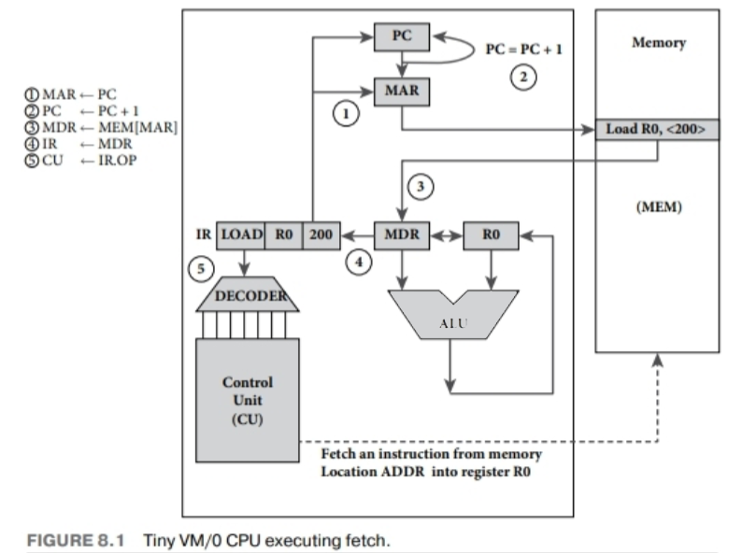
VM/0
Load the address of the next instruction into the MAR
Increment the Program Counter
Load the instruction into the MDR
Load the instruction into the Instruction register
Decode the Instruction
Execute
Repeat
Notes:
CS Students, you spent a semester learning how to take a high-level language, in this case the Pascal-like PL/0, tokenize it, parse it, and ultimately translate it into a binary form that can be immediately executed by the computer through that Fetch, Decode, and Execute cycle.
You took great pains to make sure that the input code satisfied the standards, the grammar, of the PL/0 language. You made sure that no variables were left undeclared, no loops left unclosed, and no subroutines unreturned. It was painful, but at the end you had binary code that executed on our cute little VM/0 machine.

Slide 3
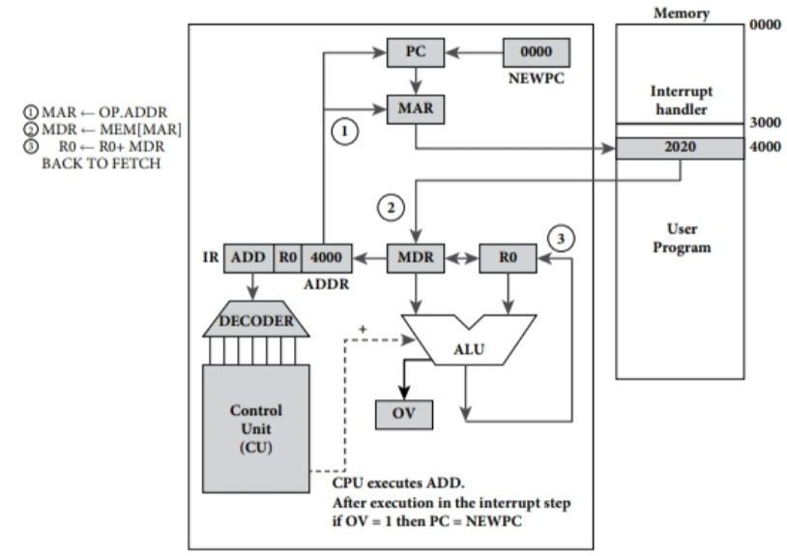
VM/0, now with Error Handling
We add two new hardware components:
An Overflow flip-flop that gets set when an overflow condition occurs.
A register (NEWPC) that stores a special memory address.
Before the next instruction, the CPU checks the OV flag. If set, it executes the instruction at NEWPC, our error handler.
Notes:
CS Students, you spent a semester learning how to take a high-level language, in this case the Pascal-like PL/0, tokenize it, parse it, and ultimately translate it into a binary form that can be immediately executed by the computer through that Fetch, Decode, and Execute cycle.
You took great pains to make sure that the input code satisfied the standards, the grammar, of the PL/0 language. You made sure that no variables were left undeclared, no loops left unclosed, and no subroutines unreturned. It was painful, but at the end you had binary code that executed on our cute little VM/0 machine.
But what if I told you that it wasn't enough? That no amount of syntax checking or clever parsing techniques could save your system from disaster?
What if...your code has bugs? What if, for example, we compute a value that exceeds the architecture's max integer size?
Our current machine, VM/0 can't really handle that. At best, a bug in your code will generate incorrect results. At worst, it can crash the whole system. So what can we do about it?
In a pattern that we will see throughout this class, we are going to expand our architecture a little and extend our execution cycle just a tad. Let's add a simple flip-flop circuit that gets set whenever the ALU detects an overflow condition.
Now, add an extra step in our execute cycle where, before the next instruction gets fetched, we check to see if our Overflow bit has been toggled.
If it has, we go into an error state. We add one more register, let's call it OVERFLOW, which contains the memory address of an error handler. When the switch is flipped, the CPU loads the address from the overflow register and executes that code instead.
This is our error handler. This error handler then communicates the failure to the calling program and then gracefully stops the failed program.
Phew! We saved the system from catastrophe, saved our program from erroneous data and can now get to work debugging our program and trying again.

Slide 4
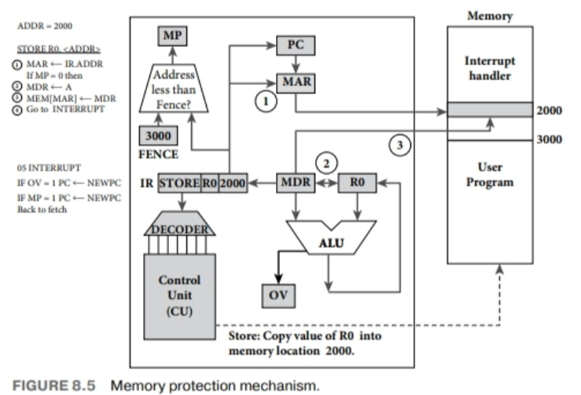
VM/0, now with Memory Protection
If we want to load more than one program in memory, we need to give them bounds. Record the max extent of a process in a FENCE register.
Add some hardware to do a simple check of the requested address with the FENCE value.
Add another flip-flop to flip when a request exceeds the bounds.
See a pattern? What should we do next?
Notes:
As you can probably guess, we can extend this pattern out to handle all sorts of situations (spoiler alert!). Now that we have a reliable way of diverting the CPU to various fixed subroutines, we can work with various kinds of hardware. Like, wouldn't it be nice if we could give a task to a peripheral, and patiently wait for it to tell us when its ready with data. That is, that the device could INTERRUPT the current line of execution by setting a flag and execute device-specific code....We now have the Fetch-Decode-Execute-Interrupt cycle.
- But we also have a new dilemma! Again, another pattern in computer science solutions often beget more problems, albeit good problems in the sense that as we continue to solve problems, the capabilities of our computers continue to expand.

Slide 5
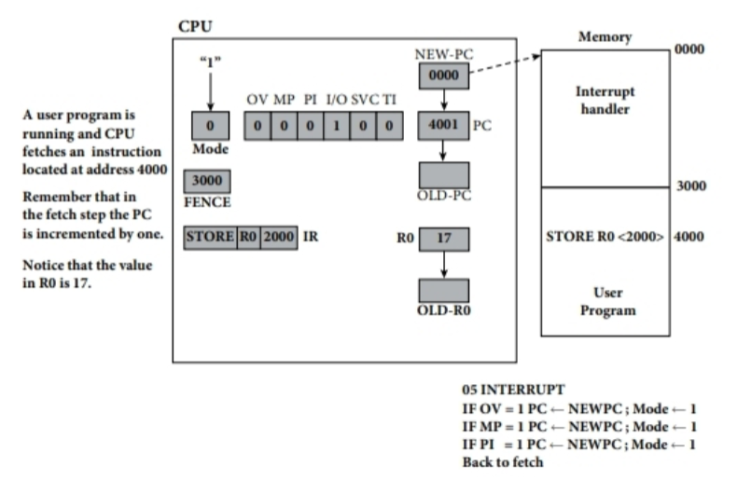
Privileged Instructions have entered the chat!
Protecting the Fence Register The Fence register can be overwritten by programs, allowing access to other processes’ memory spaces. We need to prevent “ordinary process” code from manipulating it.
The Mode Bit and Privileged Execution Mode Instructions are divided between Privileged and Unprivileged modes. Opcodes above a certain value are considered privileges. Set a Mode bit at runtime designating the mode the system is running in. If the Mode is unprivileged and the opcode trying to execute is in the privileged range, raise an error.

Slide 6
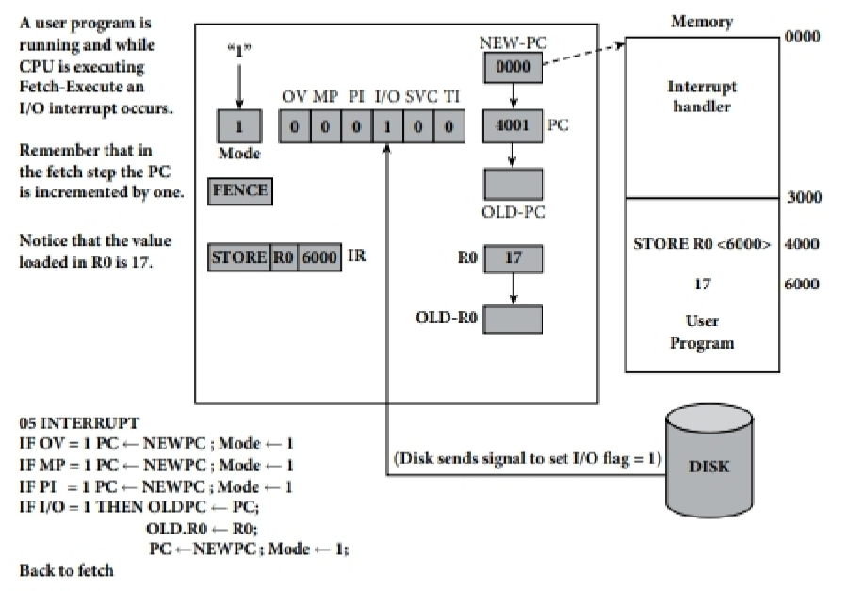
VM/0 with I/O Interrupt
Just like before, we add another flip-flip, another register to store PC information and a register to store the previous data stored in R0.
Now we can switch between the I/O handler routine and the calling program. The new registers allow us to save program state, run the I/O, and then restore.

Slide 7
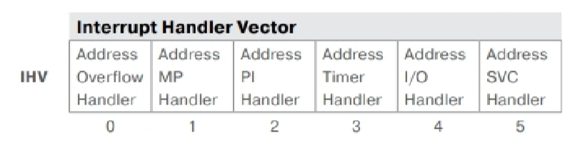
THE PATTERN CONTINUES
SYSTEM CALLS We can now allow programs to make requests of the system and change between execution modes. And now the space that was previously populated by a handful of routines has expanded greatly into a library of functions that are available to processes.
TIMERS Timer interrupts now allow the system to take control and, as we’ll see in a future episode, interrupt a running process so that another can be run in its place.
By now you’ve seen the pattern. We add more flip-flops, registers, and handler routines in system memory.
Instead of an array of flip-flops, we have one unified register, the Interrupt Handler Vector.

